Slide 1
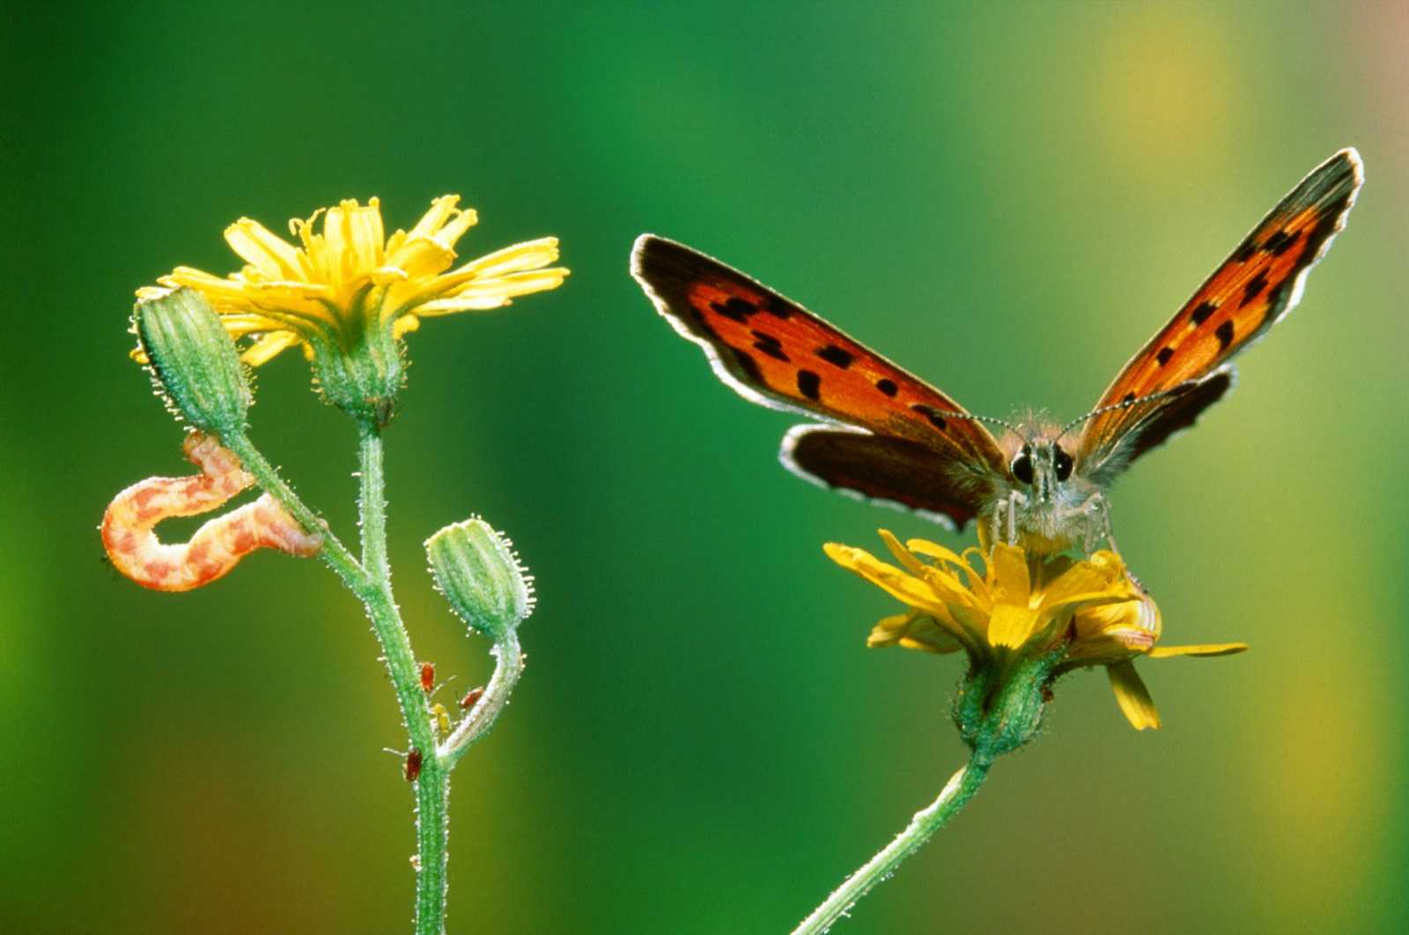
Change and Transition
Tim Dyer 2017
Notes:
All based on William Bridges, Transition and Change
I have the 2nd edn on kindle.

Slide 2



Slide 3
Change and transition
Change | Transition
The way things will actually be different | How individuals move through the stages of accepting and adjusting to the differences
Shift in visible and tangible externals of a situation – change is usually expressed in external events | Psychological and emotional process that individuals experience in order to relinquish one way and embrace a new way of doing things.
Outcome focussed: what has changed | Process focussed: how we will get there and how we will manage through this
Often happens quickly and definitely | Takes significant time and works through a range of phases at different paces for different individuals
Notes:
His key point: we all talk about change.
Change is an event. It can take place quickly. Defined. Definite.
Transition is a psychological process. Transition is how people go through the change and adjust, psychologically and emotionally.
The success of a change depends on how well you pastorally care for people as you lead them through the process.
If you stuff the process up you end up making a mess of the event.
They need to be done together.

Slide 4
Types of Change and Transition
Natural anticipated life cycle transition – natural growth, sometimes decline, most leadership changes (NAT)
Vision energised / enabled transition – change as an outcome of visionary leadership (VET)
Forced adjustment transition – unwelcome and often resisted change - mergers, closing, demographic change, some leadership changes (FAT)
Crisis induced transition – a result of significant conflict, misconduct, death or critical incident e.g. fire (CRIT)
Notes:
This is a little bit outside of Bridges work.
NAT: Change is natural. Due to leadership change. Natural life cycle change. They are NATs (natural anticipated transitions), like when a parent passes away. It’s still hard, but we see it coming. We cope with these changes differently to others.
VET: Other changes are intentional, but driven by Vision, so not just natural. Eg. To be more discipleship driven, or more outwardly focused. VET changes.
FATs are the forced or unwelcome transitions – mergers, closures, other external circumstances that people aren’t happy about. Eg. Gentrification forcing people out; arrival or departure of mining company to a country town.
CRITs are crisis induced like a death, fire, flood, something that takes building or leadership away. Again deal with these differently.
**Discuss in pairs: What was the last transition you were a part of? (which type) eg. a FAT
- Reflect on how the pastoral requirements will be different for each kind. (just a comment)

Slide 5
William Bridges' model of transition
Embracing
the new
Grief and loss
Neutral zone
Disengaged
Adjustment to
new ways
Letting go
of the old
Notes:
Along the bottom is time.
At the start, lots struggling to let go. Some in neutral zone seeking to adjust. A few embracing the new.
Then follow through with time.
Along the vertical is different people who can be followed through.
For some their journey is straight into embracing the new
For some, working it through, then embrace
Etc…
Greys are the transitional times people go through as they move through the zones.
Letting go of the old:
Neutral Zone: It’s no coincidence the 10 commandments were given in the wilderness. A lot goes on in the neutral zone.
A key point is always different people at different places in the transition.
Bridges notes key shifts:
The steep line which indicates lots of people moving into neutral zone. A significant moment for establishing vision.
The steep line which indicates lots embracing the new. Also a significant moment.
Key Questions:
What new things / thinking need to be put into place to help people make the transitions
Can’t rush the process. Can take years. Level of trust in leadership can help.
Trust critical at each stage, but how trust is mediated to the group varies at each stage.
Don’t cut the ‘wilderness’ short. Ie. The neutral zone. Give time for thinking to be reshaped so we can be ready for the new zone. (he uses the example of Israel needing to have time in the wilderness to leave the idolatry behind etc. God was creating a new nation, not just moving their location.

Slide 6
Processing transition
Accepting the need for and the reality of the change – understanding the nature of the losses and gains (release, unlocking, separation, endings, seeing the need, vision, accepting the reality) .
Experiencing the complex emotions of grief and loss.
Working through the confusion, dis-orientation and dis-engagement of the neutral phase (questioning, wondering, fatigue).
Adjusting to new roles, new relationships and new processes. Dealing with unexpected realities in the new situation.
Investing emotionally in the new situation in terms of personal commitment (connection, engagement, re-integration, beginnings, energising)
Notes:
These are colour coded.
To leave the old, people need to accept the need, etc…
The complex emotions of grief and loss. Task: put all the emotional events on the floor eg. Farewell, taking leave… Then asked the person to walk the journey and at the end say ‘I am no longer the pastor of …’ Can have significant emotional impact. If don’t acknowledge this process, it can turn up again later.
Neutral phase… the pastor who feels in limbo phase after finishing and before restarting. Disorientation is good because it allows reworking of new rhythms and disciplines for the future. Bridges says this is a really important phase. Don’t rush it.
Adjusting to the new realities…
Investing emotionally in the new

Slide 7
Transition processes
Individuals process these tasks at different paces over time. Transition is idiosyncratic and differs based on individual's personalities and histories.
These diagrams are simplified. The tasks are not necessarily distinct and often overlap or may be revisited. Colour coded to last slide.
Notes:
Transition looks really different for different people.
Draw a vertical line through this diagram at any point and it shows:
Managing change means there will be people at different stages at any one point in time. Those who continue to resist. Those who simply need more time, encouragement, vision etc. Those who wonder why haven’t moved right on already!
Remembering the need to tend to the emotional ‘grey’ times.

Slide 8
Leading through transition
The tasks of effective leadership vary through the transition process.
Clear visionary leadership is needed to enable the release / disconnect process
Pastoral leadership is essential through the neutral phase where there is significant anxiety, worry and disconnection to manage
Organisational, team formation and equipping leadership is required to enable engagement / re-connection / empowerment toward new ways of doing things.
  These three complementary modes of leadership are rarely found in one person.

Slide 9
Dimensions of change
What is changing: Established practices, rules, roles, or goals?
What is driving this change: Is this forced change, are we choosing to address issues or have we developed a vision for a different future?
How will change be facilitated: Pushed and dragged – tended and held, are we participants or recipients?
Notes:
Tim skipped this??

Slide 10
Peer to peer leadership coaching
Share a change management issue you are currently aware of in your leadership.
Reflect on where you are in the transition process and where your team members are.
What elements of leadership do you need to sharpen to facilitate this transition well?
Notes:
Good activity if time.

