Slide 1
Visioning Forum 1
Establishing PURPOSE

Slide 2
3 Key Questions for Churches to ask
Do we have an honest picture of who we are?
Do we have a shared vision of where we are going?
Do we have a clear understanding of the next steps necessary to take in this journey?

Slide 3
3 Basic Assumptions
Growth is desired by God & a natural outcome of healthy churches.
It is the Holy Spirit that causes churches to grow.
Prayer is foundational for any healthy church.

Slide 4

Good
Memories

Slide 5
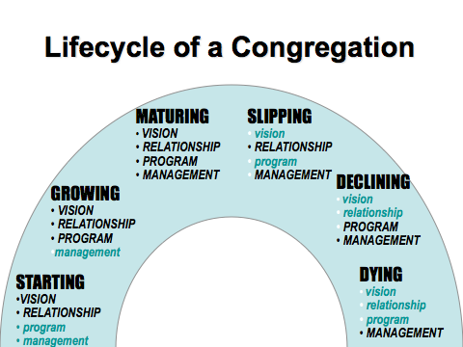
Lifecycle of a Congregation

Slide 6
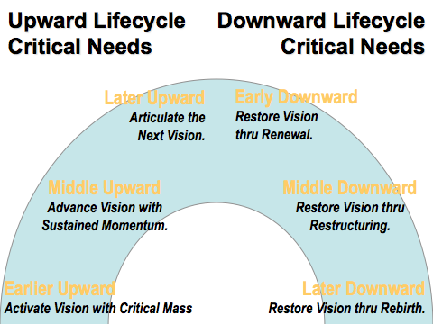
Upward Lifecycle
Critical Needs
Downward Lifecycle
Critical Needs

Slide 7

Critical Issues

Slide 8
Purpose, Values & Vision
PURPOSE why we exist

Slide 9
Purpose, Values & Vision
PURPOSE why we exist
VALUES drive the way we do things around here

Slide 10
Purpose, Values & Vision
PURPOSE why we exist
VALUES the way we operate – the way we do things around here
VISION our future destination – a word picture of what we think the future might look like under God

Slide 11
Purpose, Values & Vision

Slide 12
Purpose, Values & Vision
PURPOSE determined Biblically

Slide 13
Purpose, Values & Vision
PURPOSE determined Biblically
VALUES uncovered not created

Slide 14
Purpose, Values & Vision
PURPOSE determined Biblically
VALUES uncovered not created
VISION imparted by God, discovered through prayer, acknowledged by the church body

Slide 15
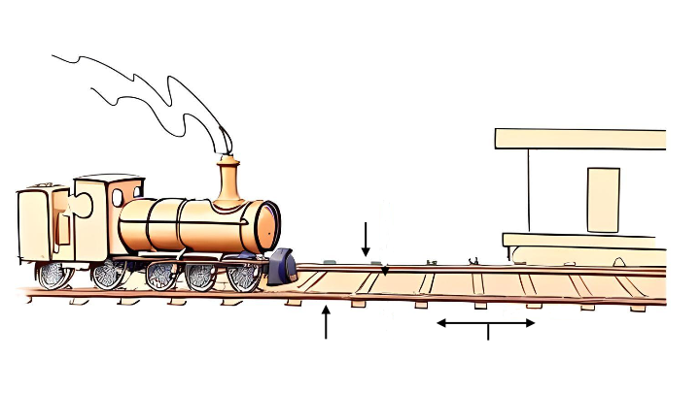
The importance of Purpose, Values & Vision
Your
Baptist Church
Vision
Purpose
Values
Strategic Steps

Slide 16


Is our purpose statement:
Biblically based?
One sentence?
Over-arching rather than specific?
Applicable to most churches?
Timeless? ie. it will never go out of date
Checking our Purpose Statement
Remember: Purpose is why we exist

Slide 17
Are these values:
Evident in the history / life of the church?
Do they feel like they ‘fit’?
Do they evoke a ‘gut reaction’? (an emotive response)
Are they ‘realised’ or ‘aspirational’ values?
Checking our Values Statement
Remember: Values drive the way we do things around here

Slide 18
Has this vision statement:
Been given by God?
Been the subject of significant prayer in the life of the church?
Been acknowledged & affirmed by the church Body?
A future aspect? (not describing things presently)
A specific nature? (progress is measurable)
Checking our Vision Statement
Remember: Vision is our future destination - a word picture of what we think the future might look like (under God)

Slide 19
“The purpose is part of the ministry’s congregational heart and soul. It is why the ministry exists...”
Malphurs, Advanced Strategic Planning, 105

Slide 20
Establishing PURPOSE
could apply to any church in any place
still value in formulating own clear statement
usually the most straightforward, but fundamentally important, nonetheless
complements a vision statement that is a more concrete picture of a ‘future destination’ that looks forward for this church at this time in this place

Slide 21

Purpose Reflection
individually: read & reflect on passages – what should be included in our church purpose statement – list ideas (not about how we ‘word’ it)
small groups: share list with each other - one group member records any ideas that arise more than once amongst the group members
large group: facilitator has each small group share one point (until the list is exhausted) noting how many groups had the same answer

Slide 22

VALUES
Identification
Exercise

Slide 23
End of Forum 1
Establishing PURPOSE

