Slide 1
Visioning Forum 2
Uncovering VALUES

Slide 2
3 Key Questions for Churches to ask
Do we have an honest picture of who we are?
Do we have a shared vision of where we are going?
Do we have a clear understanding of the next steps necessary to take in this journey?

Slide 3
3 Basic Assumptions
Growth is desired by God & a natural outcome of healthy churches.
It is the Holy Spirit that causes churches to grow.
Prayer is foundational for any healthy church.

Slide 4
Purpose, Values & Vision
PURPOSE why we exist

Slide 5
Purpose, Values & Vision
PURPOSE why we exist
VALUES drive the way we do things around here

Slide 6
Purpose, Values & Vision
PURPOSE why we exist
VALUES drive the way we do things around here
VISION our future destination – a word picture of what we think the future might look like under God

Slide 7
Purpose, Values & Vision

Slide 8
Purpose, Values & Vision
PURPOSE determined Biblically

Slide 9
Purpose, Values & Vision
PURPOSE determined Biblically
VALUES uncovered not created

Slide 10
Purpose, Values & Vision
PURPOSE determined Biblically
VALUES uncovered not created
VISION imparted by God, discovered through prayer, acknowledged by the church body

Slide 11
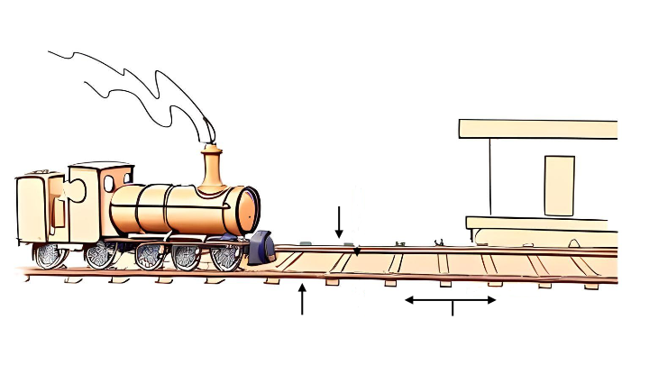
The importance of Purpose, Values & Vision
Your
Baptist Church
Vision
Purpose
Values
Strategic Steps

Slide 12

Draft Purpose Statement
FEEDBACK

Slide 13


Is our purpose statement:
Biblically based?
One sentence?
Over-arching rather than specific?
Applicable to most churches?
Timeless? ie. it will never go out of date
Checking our Purpose Statement
Remember: Purpose is why we exist

Slide 14
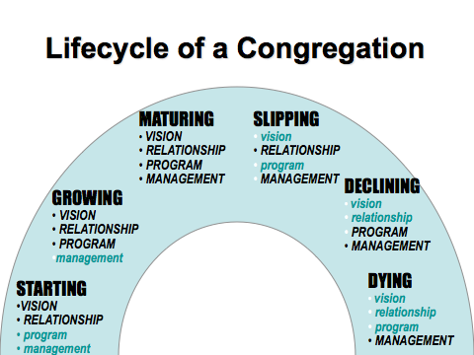
Lifecycle of a Congregation

Slide 15
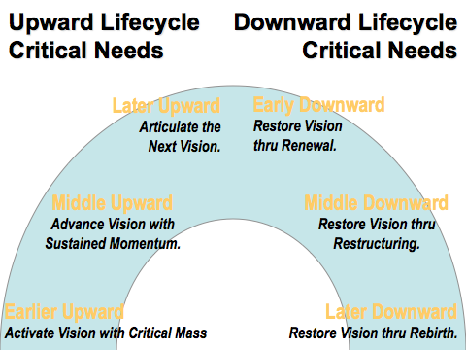
Upward Lifecycle
Critical Needs
Downward Lifecycle
Critical Needs

Slide 16

Critical Issues

Slide 17
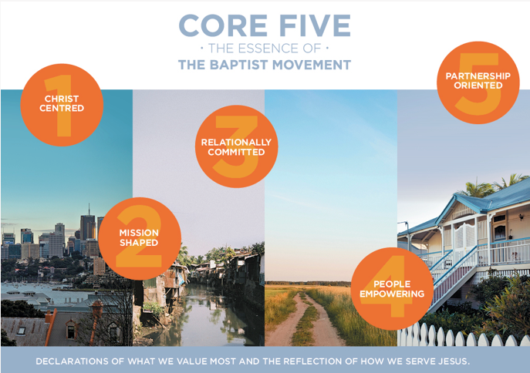

Slide 18
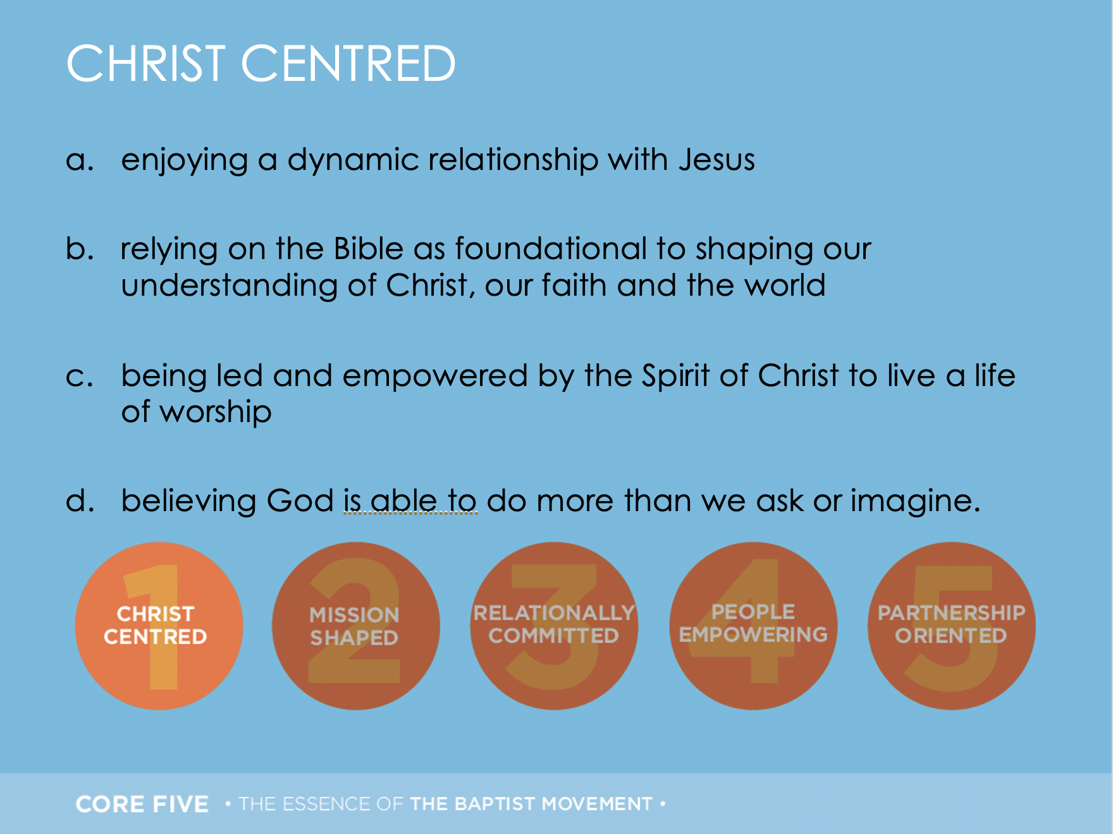

Slide 19
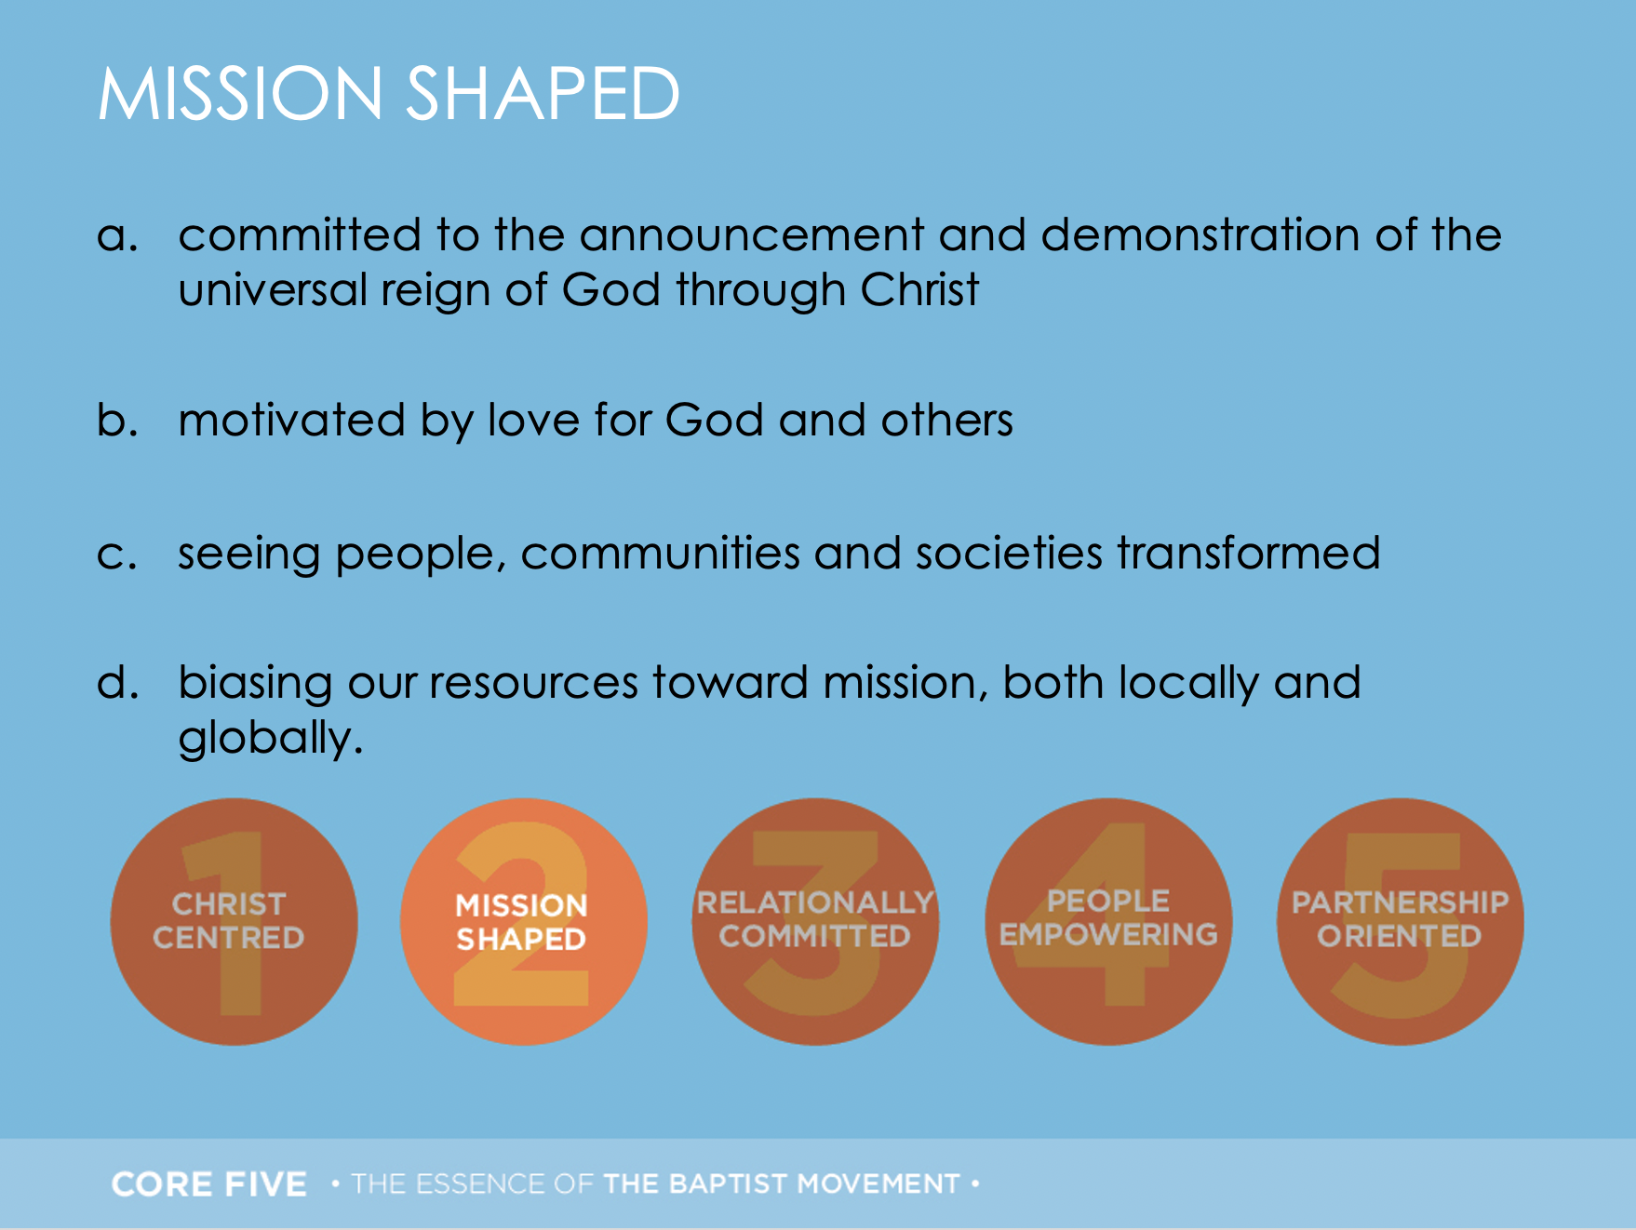

Slide 20
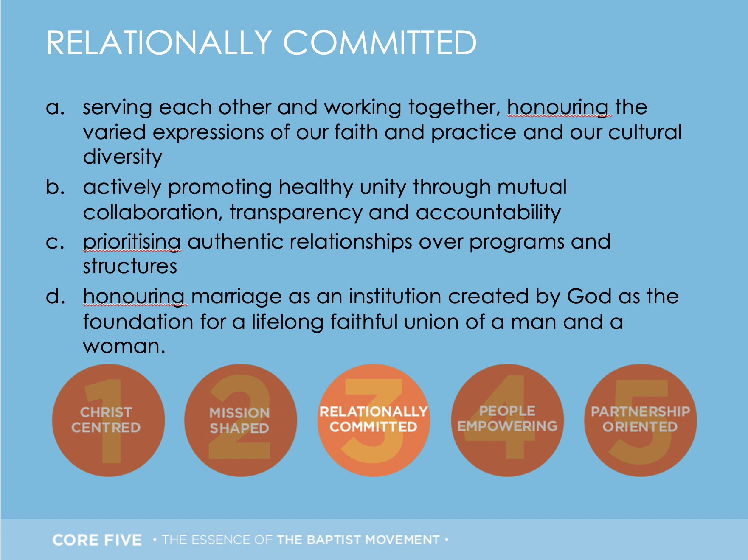

Slide 21
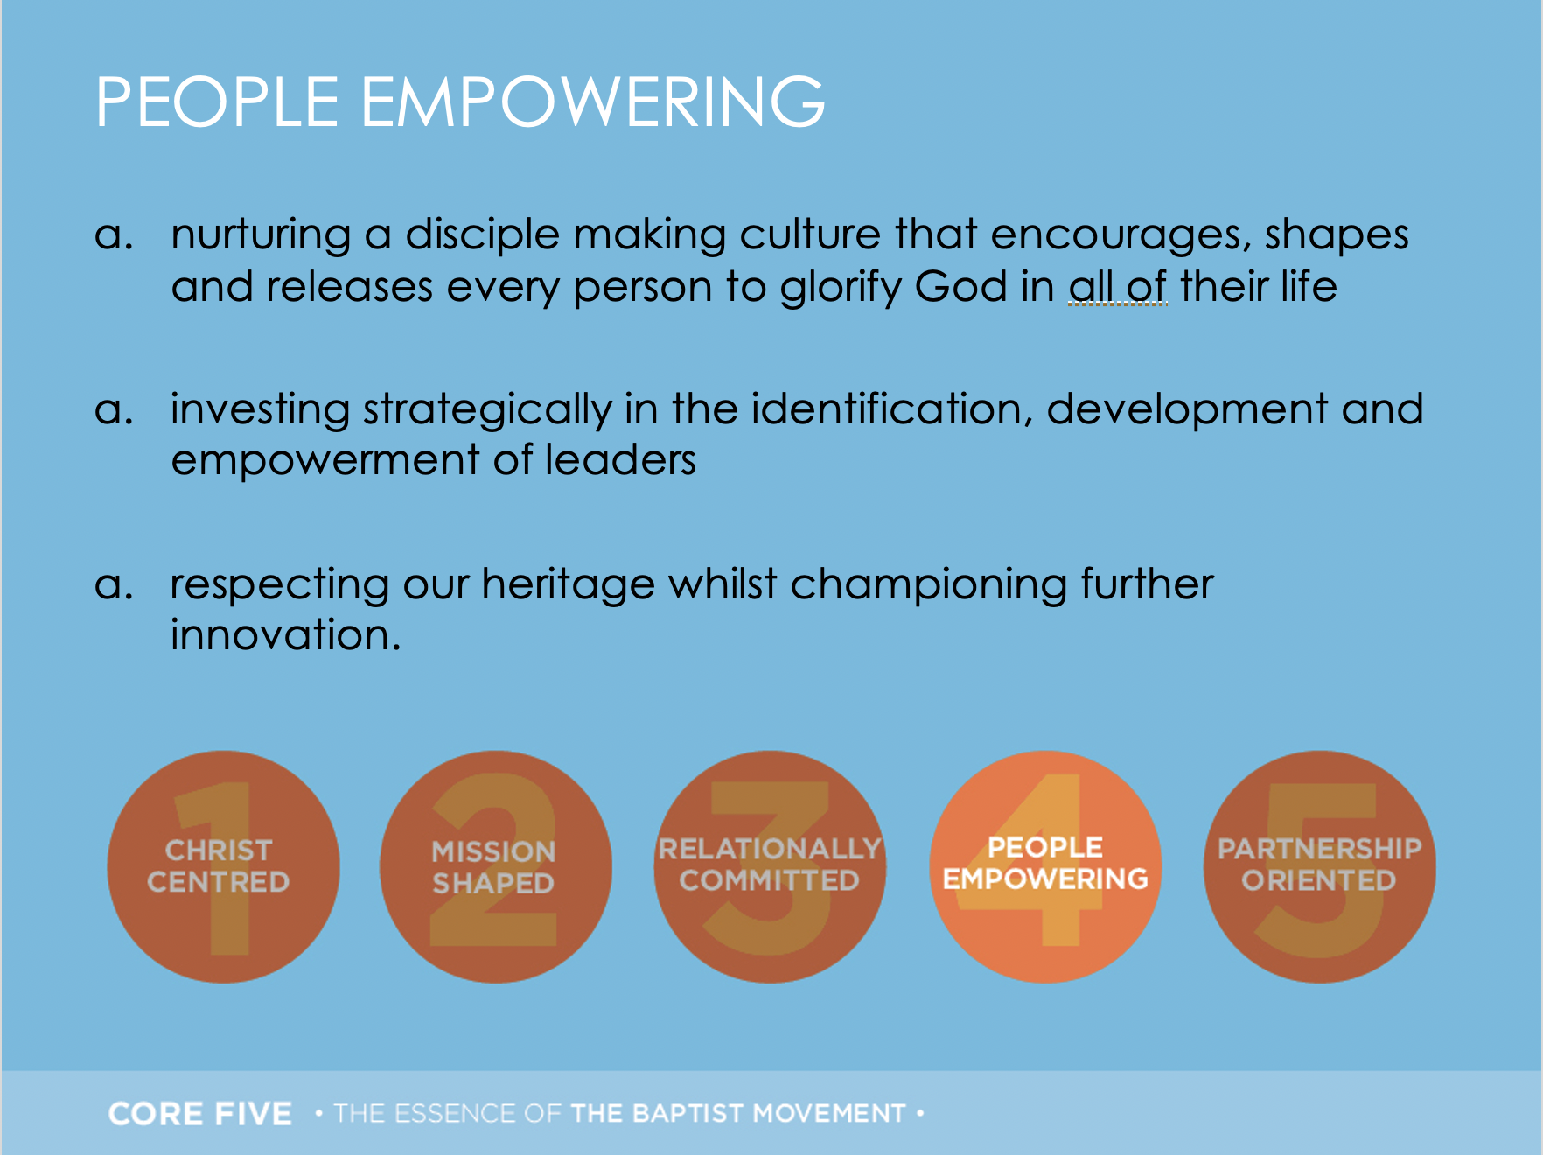

Slide 22
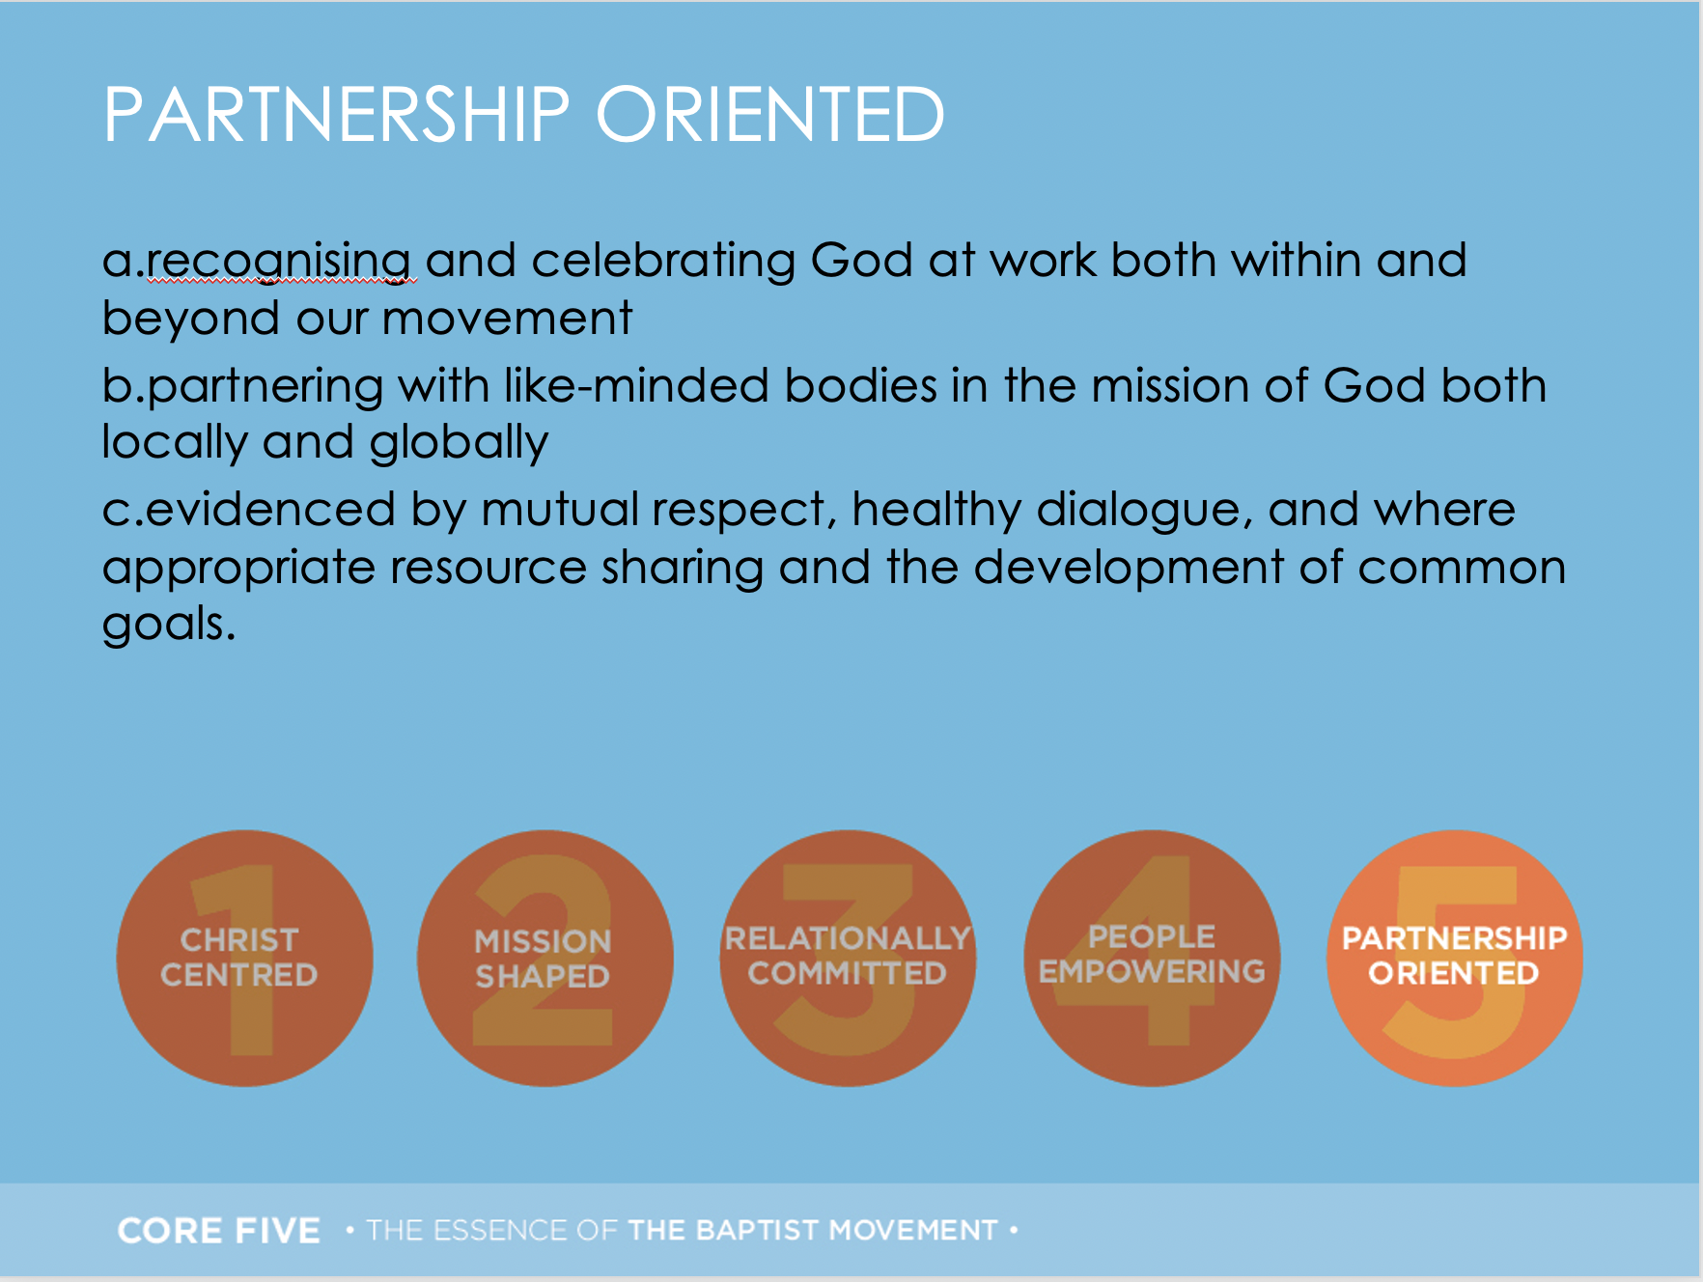

Slide 23
Values
Values answer the core question:
Why do we do what we do?

Slide 24
Defining Core Values
Core values are constant
Core values are passionate
Core values are Biblical
Core values build quite slowly and change very slowly
Core values drive the ministry

Slide 25
Five Kinds of Values
Conscious vs unconscious values
Shared vs unshared values
Personal vs organizational values
Actual vs aspirational values
Good vs bad values

Slide 26
Are these values:
Evident in the history / life of the church?
Do they feel like they ‘fit’?
Do they evoke a ‘gut reaction’? (an emotive response)
Are they ‘realised’ or ‘aspirational’ values?
Checking our Values Statement
Remember: Values drive the way we do things around here

Slide 27
Discovering a Church’s Values
What is a good church-related memory?
What values do these memories reveal?

Slide 28
9 Possible Values for our Church
1
2
3
4
5
6
7
8
9
Aim: 3 CORE VALUES ‘Real’ vs ‘Aspirational’ ‘Missing Values’

Slide 29

VALUES
Banner Activity

Slide 30
Negative Values
Churches have both positive and also usually some negative values. Whilst we often don’t talk about the negative values they are still very powerful in the life of any church.
What are some values, attitudes, or behaviours that might hold us back at present?

Slide 31
Church Size
Churches must transition to new stages.
It doesn’t happen naturally and it can’t happen without change!

Slide 32


Slide 33
Blended Ecology
Simple Churches
Neighbourhood Churches
Regional Churches
Resource Churches

Slide 34
Is God calling us to grow in size or by sending?

Slide 35
Vision
Exercise
Remember:
Vision is our future destination
It is a word picture of what we think the future might look like (under God)
It needs to be in keeping with our values.

Slide 36
End of Forum 2
Uncovering VALUES

