Slide 1
Visioning Forum 3
Surfacing VISION

Slide 2
3 Key Questions for Churches to ask
Do we have an honest picture of who we are?
Do we have a shared vision of where we are going?
Do we have a clear understanding of the next steps necessary to take in this journey?

Slide 3
3 Basic Assumptions
Growth is desired by God & a natural outcome of healthy churches.
It is the Holy Spirit that causes churches to grow.
Prayer is foundational for any healthy church.

Slide 4
Purpose, Values & Vision
PURPOSE why we exist

Slide 5
Purpose, Values & Vision
PURPOSE why we exist
VALUES drive the way we do things around here

Slide 6
Purpose, Values & Vision
PURPOSE why we exist
VALUES drive the way we do things around here
VISION our future destination – a word picture of what we think the future might look like under God

Slide 7
Purpose, Values & Vision

Slide 8
Purpose, Values & Vision
PURPOSE determined Biblically

Slide 9
Purpose, Values & Vision
PURPOSE determined Biblically
VALUES uncovered not created

Slide 10
Purpose, Values & Vision
PURPOSE determined Biblically
VALUES uncovered not created
VISION imparted by God, discovered through prayer, acknowledged by the church body

Slide 11
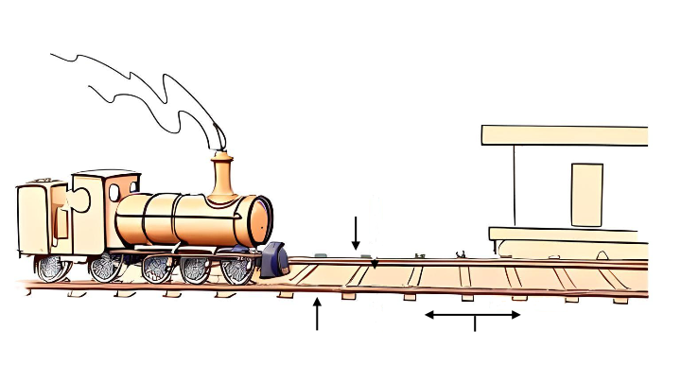
The importance of Purpose, Values & Vision
Your
Baptist Church
Vision
Purpose
Values
Strategic Steps

Slide 12
Purpose Statement
FINAL DRAFT
Put the Purpose Statement here

Slide 13

VALUES
Feedback

Slide 14
Values
Values answer the core question:
Why do we do what we do?

Slide 15
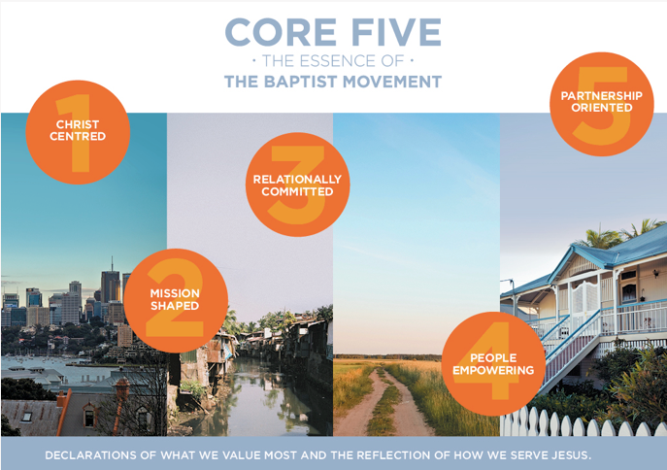

Slide 16
Our
TOP 3 VALUES
Core value 1
Core value 2
Core value 3

Slide 17


Are these values:
Evident in the history / life of the church?
Do they feel like they ‘fit’?
Do they evoke a ‘gut reaction’? (an emotive response)
Are they ‘realised’ or ‘aspirational’ values?
Checking our Values Statement
Remember: Values drive the way we do things around here

Slide 18
Our Missing Values
Missing value
Missing value

Slide 19
Our Negative Values
Negative value
Negative value

Slide 20
VISION
Remember:
Vision is our future destination
It is a word picture of what we think the future might look like (under God)
It needs to be in keeping with our values.

Slide 21
A Vision:
Encourages unity
Creates energy
Provides purpose
Fosters risk taking
Enhances leadership
Promotes excellence
Sustains ministry
Malphurs, Advanced Strategic Planning, 134-137
Why is Vision Important?

Slide 22

What does God want our future to look like?

Slide 23
Blended Ecology
Simple Churches
Neighbourhood Churches
Regional Churches
Resource Churches

Slide 24
Is God calling us to grow in size or by sending?

Slide 25
CHANGE

Slide 26
John Maxwell:
Misunderstanding
Lack of ownership
Habit patterns
Change is not worth the price
Losing security, money or control
Satisfaction factor
Negative attitude toward change in general
Lack of respect for leader
Tradition
9
Reasons People Resist Change

Slide 27
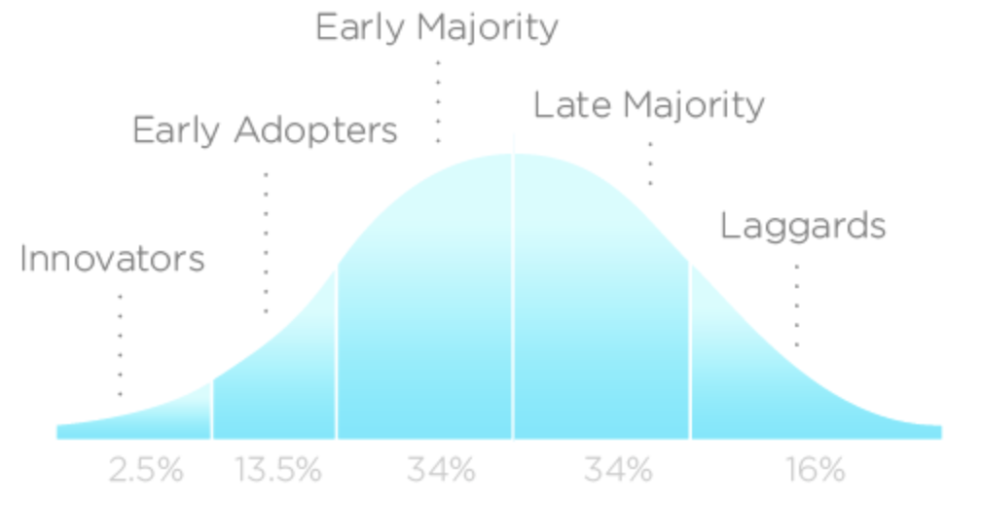
Bell Curve of Change
https://en.wikipedia.org/wiki/Technology_adoption_life_cycle

Slide 28
A Church’s Five Fold Ministry
Worship
Discipleship
Fellowship
Ministry
Evangelism

Slide 29

Dreaming Together

Slide 30
End of Forum 3
Surfacing VISION

