Slide 1
Purpose, Values & Vision

Slide 2
Introductory Exercise
You are planning a holiday for the family. You have teenage children who are on the edge of no longer coming on family holidays. You want them to come.
How do you respond to the situation?
Where will you go?

Slide 3

Vision is a future destination – a word picture of what we think the future might look like under God.

Slide 4
“The vision needs to be big enough to stir the blood, specific enough to be accomplished, and short enough to be put on a bumper sticker.”,
Borden, Hitting the Bullseye, 66

Slide 5

“On the Lord’s Day I was in the Spirit, and I heard behind me a loud voice like a trumpet, which said: “Write on a scroll what you see and send it to the seven churches … Write, therefore, what you have seen, what is now, and what will take place later.”
Revelation, 1:10-11,19

Slide 6
Is Visioning just a trendy corporate idea?
Brainstorm:
Experiences of Visioning in a church context…

Slide 7
Theological Foundations
What do you think of these premises?
Is there one which particularly resonates with you?
Are there any you find particularly questionable?

Slide 8
Theological Foundations
What is the vision (the picture of the future) highlighted in the following passages?
Is it a good vision? Whose vision is it?
Genesis 11:4
Genesis 12:2-3
Deuteronomy 8:7-10
Matthew 13:1-52
Revelation 21

Slide 9
Theological Foundations
Any other relevant Biblical passages or principles come to mind?

Slide 10
Purpose, Values & Vision

Slide 11
Purpose, Values & Vision
PURPOSE why we exist

Slide 12
Purpose, Values & Vision
PURPOSE why we exist
VALUES drive the way we do things around here

Slide 13
Purpose, Values & Vision
PURPOSE why we exist
VALUES drive the way we do things around here
VISION our future destination – a word picture of what we think the future might look like under God

Slide 14
Purpose, Values & Vision

Slide 15
Purpose, Values & Vision
PURPOSE determined Biblically

Slide 16
Purpose, Values & Vision
PURPOSE determined Biblically
VALUES uncovered not created

Slide 17
Purpose, Values & Vision
PURPOSE determined Biblically
VALUES uncovered not created
VISION imparted by God, discovered through prayer, acknowledged by the church body

Slide 18
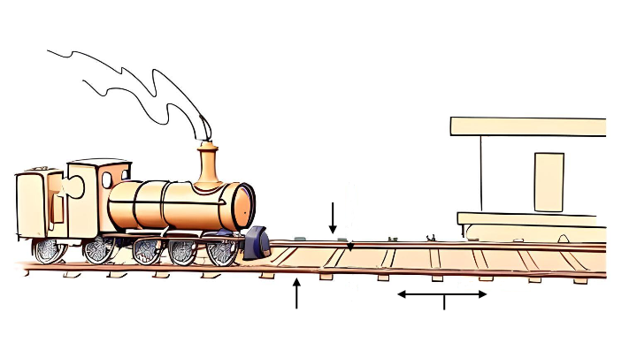
The importance of Purpose, Values & Vision
Your
Baptist Church
Vision
Purpose
Values
Strategic Steps

Slide 19


Is our purpose statement:
Biblically based?
One sentence?
Over-arching rather than specific?
Applicable to most churches?
Timeless? ie. it will never go out of date
Checking our Purpose Statement
Remember: Purpose is why we exist

Slide 20
“The purpose is part of the ministry’s congregational heart and soul. It is why the ministry exists...”
Malphurs, Advanced Strategic Planning, 105

Slide 21
Are these values:
Evident in the history / life of the church?
Do they feel like they ‘fit’?
Do they evoke a ‘gut reaction’? (an emotive response)
Are they ‘realised’ or ‘aspirational’ values?
Checking our Values Statement
Remember: Values drive the way we do things around here

Slide 22
“The constant, passionate, biblical core beliefs that drive the ministry.”
Malphurs, Advanced Strategic Planning, 83

Slide 23

For reflection: “Values eat Vision for breakfast.”

Slide 24
Has this vision statement:
Been given by God?
Been the subject of significant prayer in the life of the church?
Been acknowledged & affirmed by the church Body?
A future aspect? (not describing things presently)
A specific nature? (progress is measurable)
Checking our Vision Statement
Remember: Vision is our future destination - a word picture of what we think the future might look like (under God)

Slide 25
“A vision is a target that beckons.”
Bennis and Nanus, Leaders: The strategies for Taking Charge, 88.

Slide 26
“…unlike the values, mission, and purpose, the vision is more subject to change... Over time, the vision must be renewed, adapted, and adjusted to the cultural context in which the congregation lives. The change takes place only at the margins of the vision, not at its core. The core – the Great Commission – does not change. The details of the vision and the words used to convey them will change.”
Malphurs, Advanced Strategic Planning, 133.

Slide 27
Visioning Process

Slide 28
Developing a Vision Process
5 Important Considerations
A vision created quickly in a rush of enthusiasm will normally sit quietly in the corner and lead to complacency.

Slide 29
Developing a Vision Process
5 Important Considerations
God has a vision for this church; he is already communicating this vision. How do we assist a church to listen, articulate this, commit to it and act upon it?

Slide 30
Developing a Vision Process
5 Important Considerations
God usually speaks in many and various ways in and through his people. How do we empower a congregation to discern wisely and well?

Slide 31
Developing a Vision Process
5 Important Considerations
Vision formation always involves spiritual formation.

Slide 32
Developing a Vision Process
5 Important Considerations
Surfacing a vision is work for the spirit, the heart and the mind.

Slide 33

Developing a Vision Process
5 Key Elements
Elements that need to be understood from the outset:
Time
Participation
Listening
Wrestling
Commitment

Slide 34

The Role of the Senior Leader
Maintaining Vision
“One core duty that the lead pastor can never give away is the role of chief vision-caster. This premise does not mean that only a natural visionary can be the primary leader, for there are many ways to formulate the vision with the help of others; it does mean that only the primary leader can adequately champion the vision.”
Kaiser, Winning on Purpose, 110.

Slide 35
End of Process section

Slide 36
Purpose, Values & Vision

